Slide 1
Risk Identification for Textile Dye Suppliers
Presented By: Love Gaur

Slide 2
Business Context: The company relies on 10 global suppliers for textile dyes, a critical component in production. Any disruptions in the supply chain could impact operations, leading to delays and financial losses.
Problem Statement: How can we proactively identify and mitigate risks associated with our suppliers to ensure an uninterrupted supply chain? Key Risks Monitored: Geopolitical & Regulatory Risks Environmental & Agricultural Risks Financial & Operational Risks Supply Chain & Logistics Disruptions Market & Competitive Risks
Objective: Analyze news articles (2023-2024) using NLP models to classify risks and provide actionable insights for supply chain stability.

Slide 3
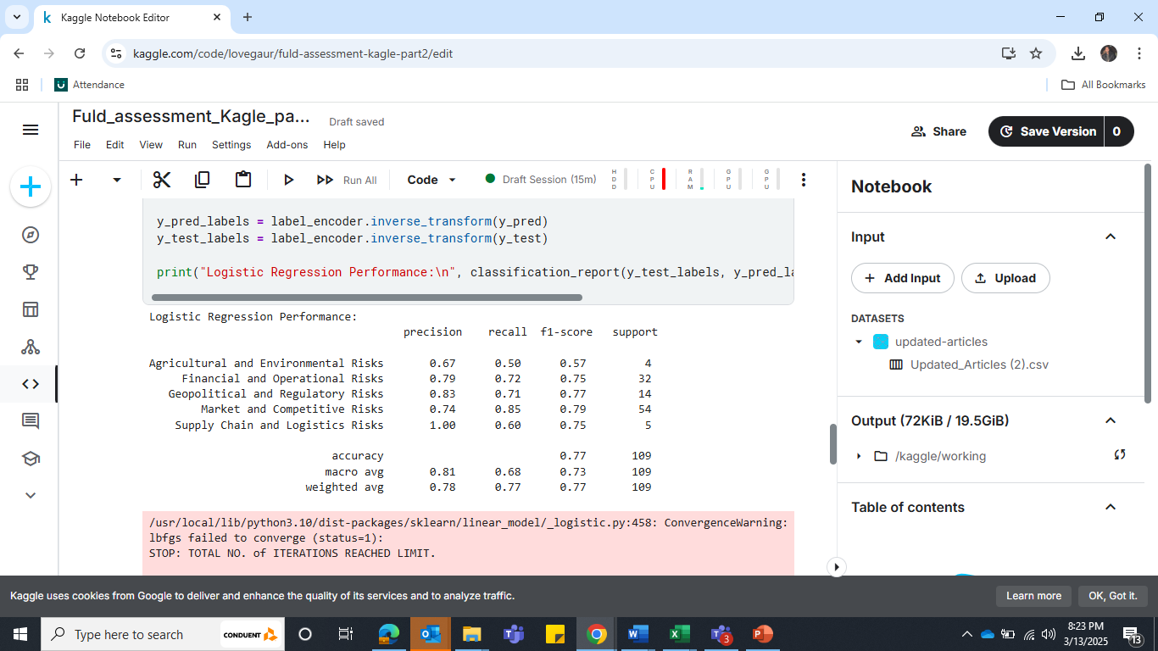
Data Processing & Filtering
There are 1418 entries and 12 variables (all are object data type) in the original dataset.
We found that several columns have missing values, including the "Full Article" column, which is crucial for our analysis.
After filtering articles from 2023 and 2024, the dataset is reduced to 854 entries, but the "Full Article" column still has missing values, requiring web scraping
Even after scraping, 97 articles remain missing due to website inaccessibility or permission restrictions.
These records with missing Full Articles are removed from the dataset.
Finally, articles are filtered based on 10 specified suppliers, resulting in a final dataset of 550 articles for analysis.
Built Models
Logistic Regression Performance: Classification report
Overall Accuracy: 77%, indicating a reasonably good classification performance.
Market & Competitive Risks (F1-score: 0.79), showing strong precision and recall.
Agricultural & Environmental Risks (F1-score: 0.57) and Supply Chain & Logistics Risks (F1-score: 0.75) have lower recall, suggesting misclassification issues.

Slide 4
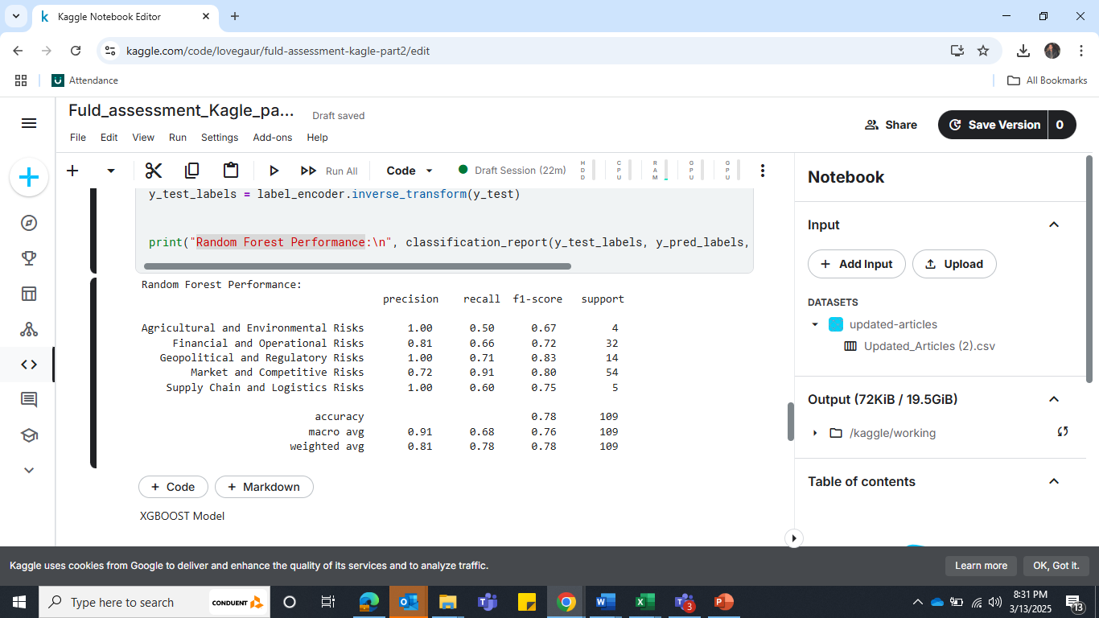
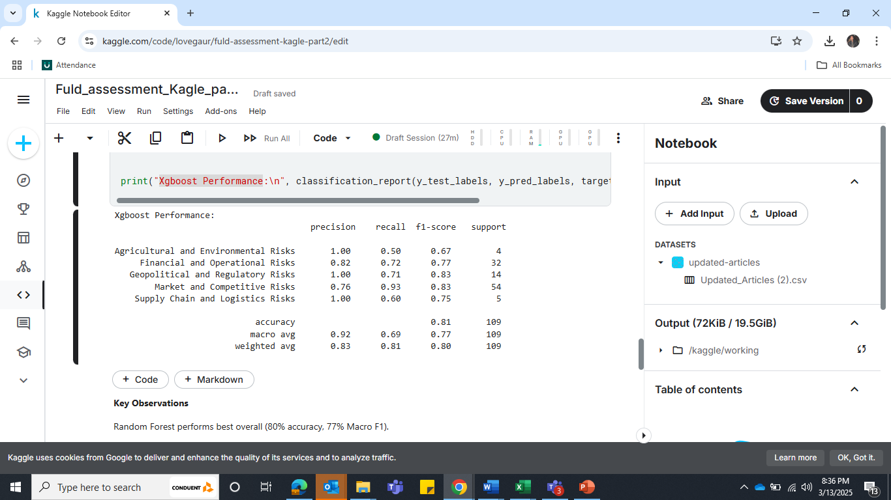
Random Forest Performance: Classification report
Overall Accuracy: 78% – A slight improvement over Logistic Regression (77%).
Geopolitical & Regulatory Risks (F1-score: 0.83) with 100% precision but recall could be improved.
Higher precision across most categories, especially for Geopolitical & Regulatory Risks and Agricultural & Environmental Risks (1.00 precision).
Market & Competitive Risks now have higher recall (0.91), meaning fewer misclassifications.
Agricultural & Environmental Risks recall remains low (0.50), impacting F1-score (0.67).
Supply Chain & Logistics Risks also has low recall (0.60) despite perfect precision.
Xgboost Performance: Classification report
Overall Accuracy: 81% – Highest among all models (Logistic Regression: 77%, Random Forest: 78%).
Higher recall for Market & Competitive Risks (0.93) → Fewer misclassifications. Highest F1-score (0.83) for both Market & Competitive Risks and Geopolitical & Regulatory Risks. Improved precision across all categories (above 0.75), making it the most balanced model.
Agricultural & Environmental Risks recall is still low (0.50), impacting F1-score (0.67). Supply Chain & Logistics Risks recall (0.60) remains unchanged from previous models.

Slide 5
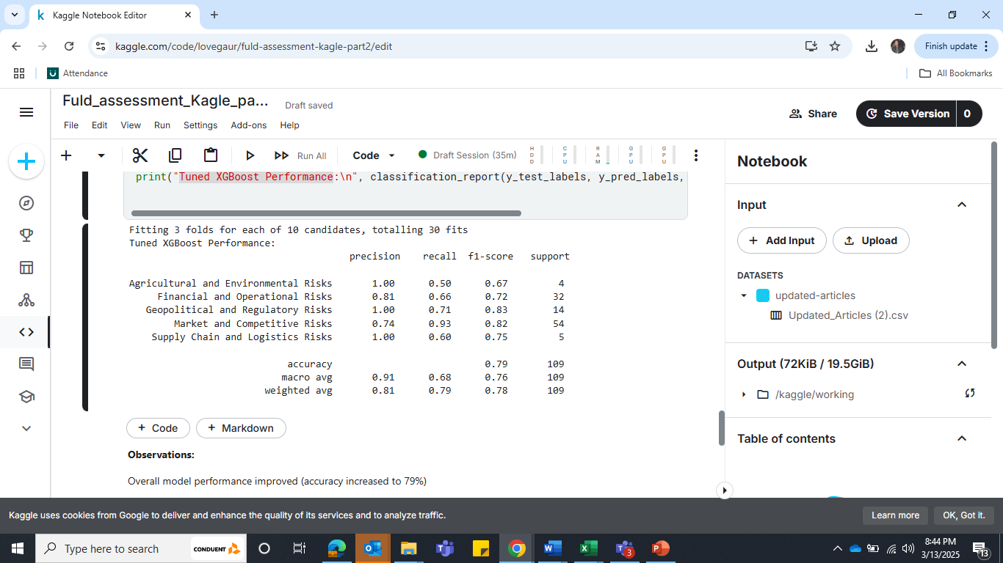
Tuned XGBoost Performance: Classification report
Overall Accuracy: 79% – Slight drop from the untuned XGBoost model (81%).
Market & Competitive Risks recall remains strong at 0.93, ensuring fewer false negatives. Geopolitical & Regulatory Risks F1-score is stable at 0.83 → Model still captures this category well.
Financial & Operational Risks recall dropped to 0.66 (from 0.72 in the untuned model). Overall accuracy declined slightly (79% vs. 81%), suggesting potential overfitting in the untuned version. No improvement in Agricultural & Environmental Risks recall (0.50).
XGBoost SMOTE: Classification report
Overall Accuracy Increased: 0.81 → 0.82 Better Recall for Minority Classes:
Geopolitical & Regulatory Risks: 0.71 → 0.86 🎯
Financial & Operational Risks: 0.66 → 0.69 Macro Avg F1-score Improved: 0.76 → 0.79
Remaining Issues
Agricultural & Environmental Risks Recall Stagnant at 0.50 Supply Chain & Logistics Recall Still 0.60 Precision unchanged (~1.00) for minority classes (could indicate overfitting)

Slide 6
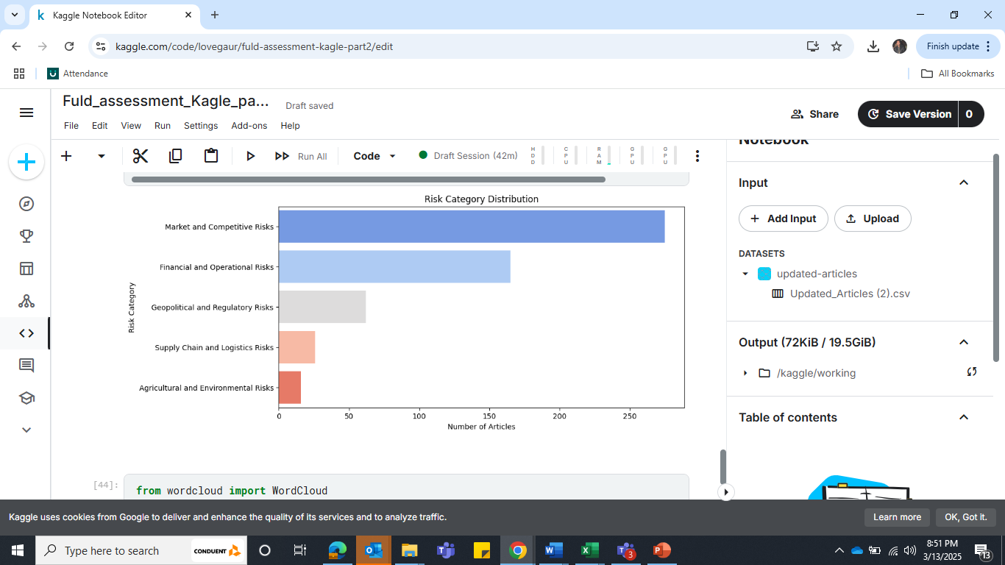
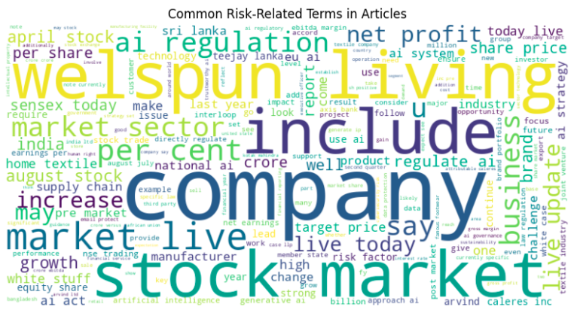
RISK Category Distribution Common Risk-Related Terms in Articles
Business Recommendations:
Prioritize Market & Competitive Risks & Financial Risks: Since these categories are the most frequent, allocate more resources to monitoring market trends, competitor strategies, and financial stability.
Invest in Competitive Intelligence Tools to track industry shifts and financial vulnerabilities.
Address Gaps in Agricultural & Environmental Risk Assessment
The low representation of this category suggests a potential blind spot in risk tracking.
Expand data collection & monitoring for climate-related risks, sustainability issues, and agricultural supply chain disruptions.
Strengthen Supply Chain Resilience
Supply Chain Risks are underrepresented, but they can have severe consequences (e.g., supplier disruptions, logistics failures).
Develop a supply chain risk dashboard to track supplier performance & geopolitical risks.
Diversify suppliers to reduce dependency on a few high-risk regions.
Adopt AI-driven demand forecasting to prepare for disruptions

